Slide 1
A smooth transition from
Reception to Year 1

Slide 2



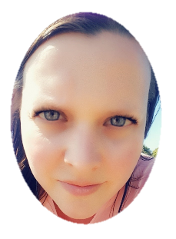
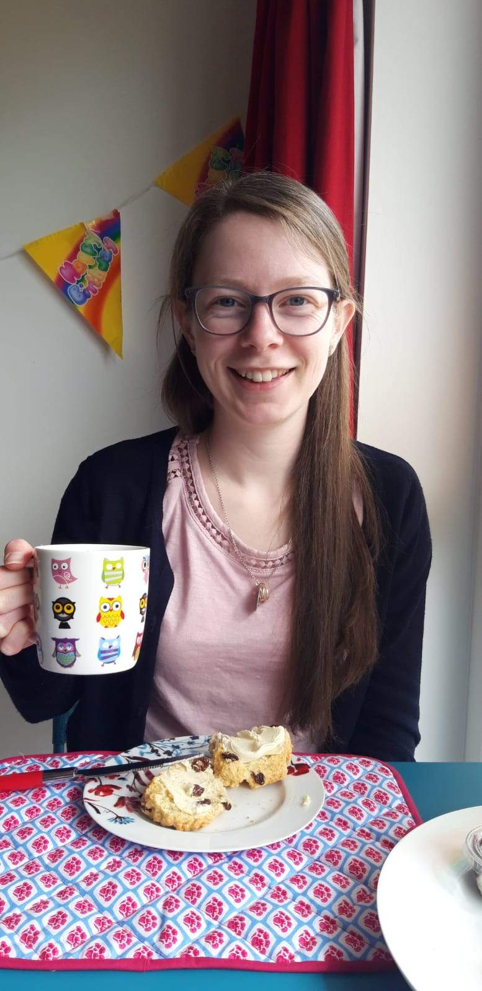
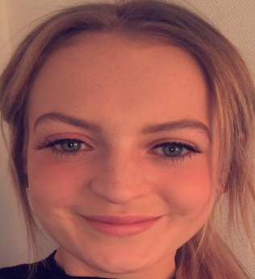
Welcome to Year 1 and 2
We will be your teachers:
Miss Hall Miss Pavier Miss Daubney
Year 1 Year 1/2 Year 2

Slide 3

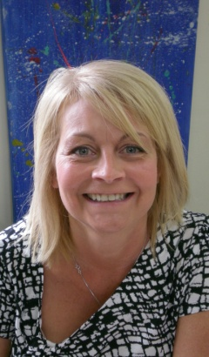
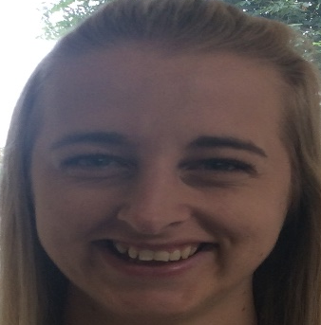
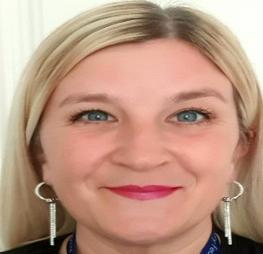
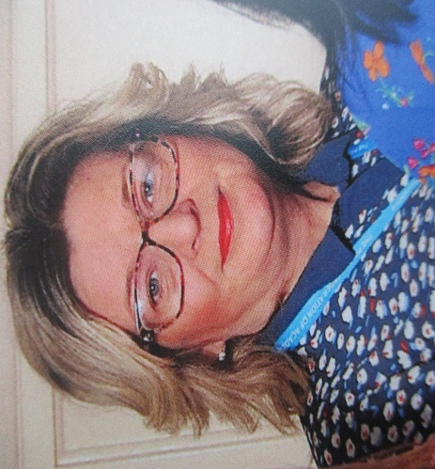
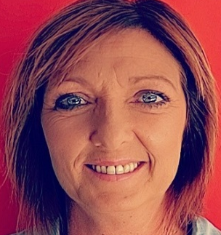
These ladies often help us in our classroom:
Mrs Dodds
Mrs Skinner
Miss Clarke
Mrs Baxter
Mrs Foulston

Slide 4
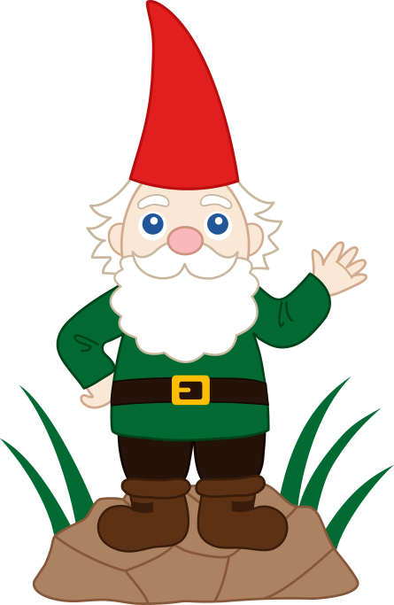
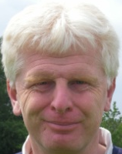
P.E.
My name is Mr Housam.
I teach PE every Tuesday afternoon.
Don’t forget your outdoor PE kit!
Please make sure that your child is able to get themselves changed as independently as possible, as it can be quite time consuming to help a class of children get changed ready for PE!

Slide 5
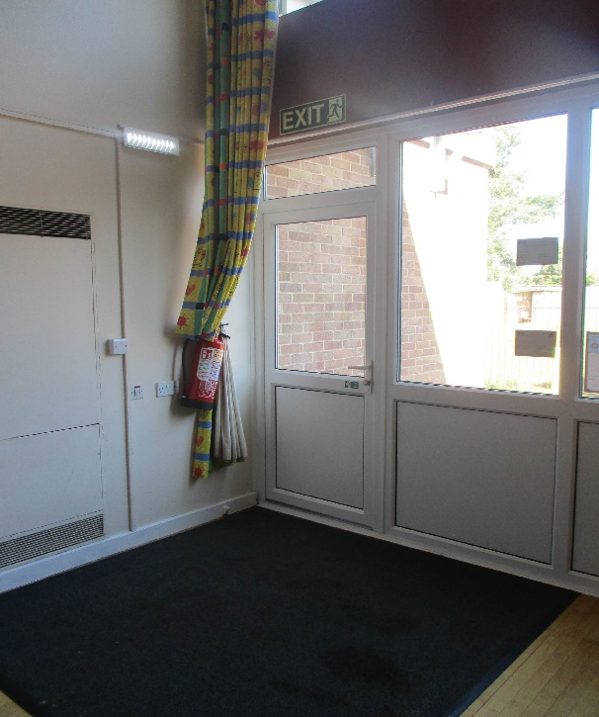

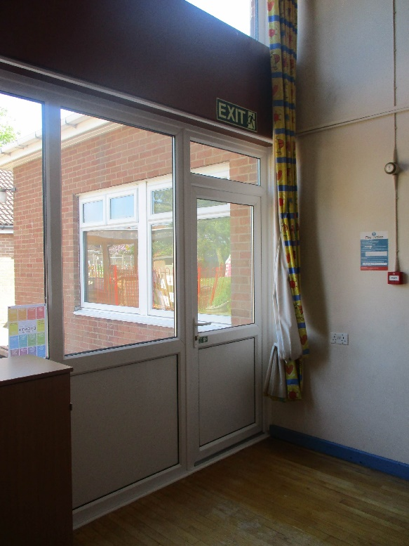
Coming in to school
Miss Pavier’s class enter and exit the school by the first infant hall door.
There will be an adult on the doors to greet your child in the morning. This is when you have the opportunity to pass messages on.
You can also speak to the class teacher at the end of the day.
Miss Hall’s class enter and exit the school by the second infant hall door.

Slide 6
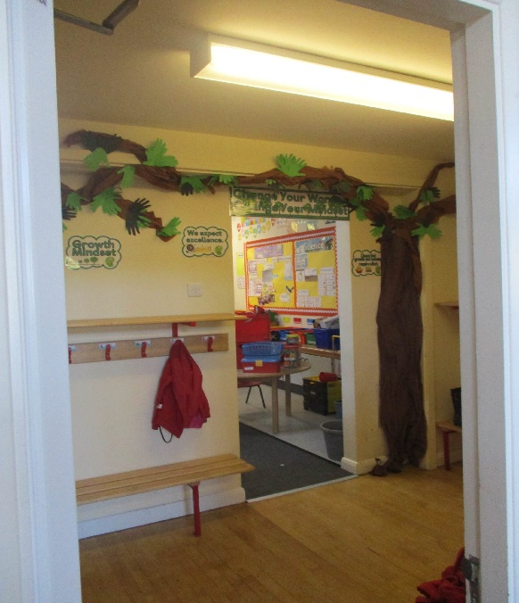

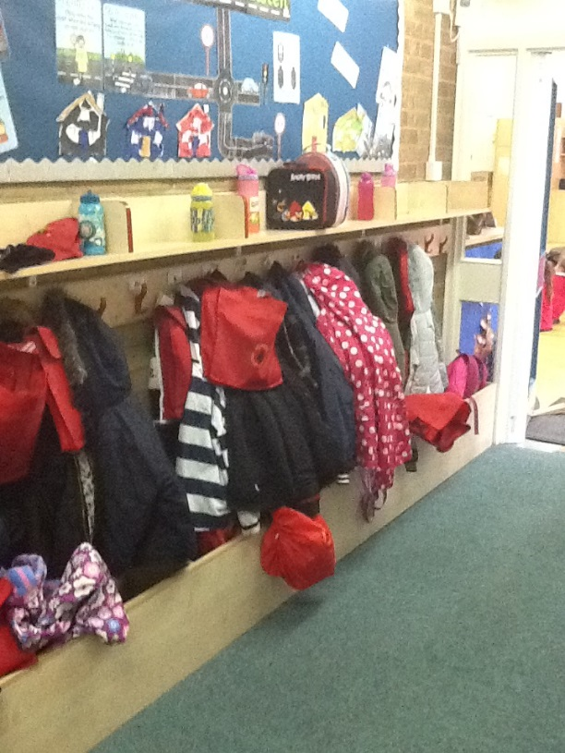

Cloakrooms
This is Miss Pavier’s cloakroom.
Look carefully for your peg name!
You can hang your coat and book bag on your peg and place your lunch box on the wooden shelf above.
This is Miss Hall’s cloakroom. Look carefully for your peg name!
You can hang your coat and book bag on your peg and place your lunch box in the wooden box underneath.

Slide 7
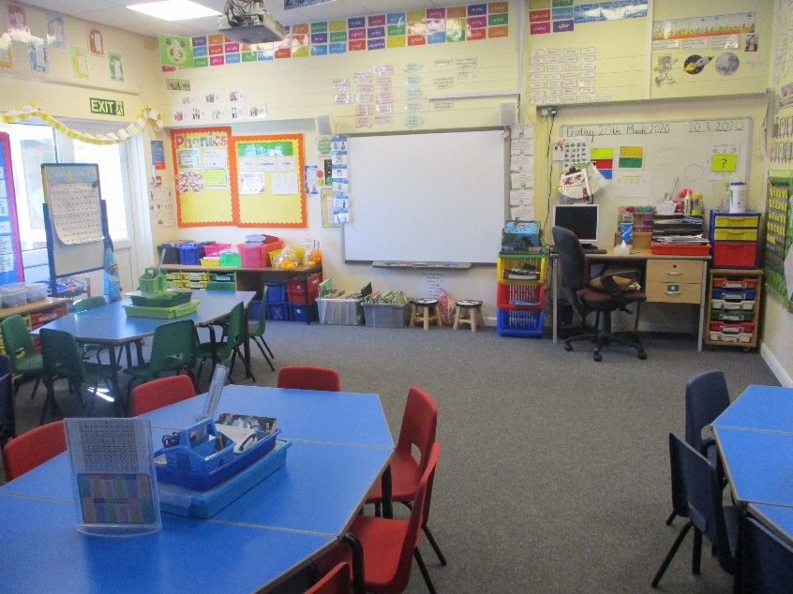
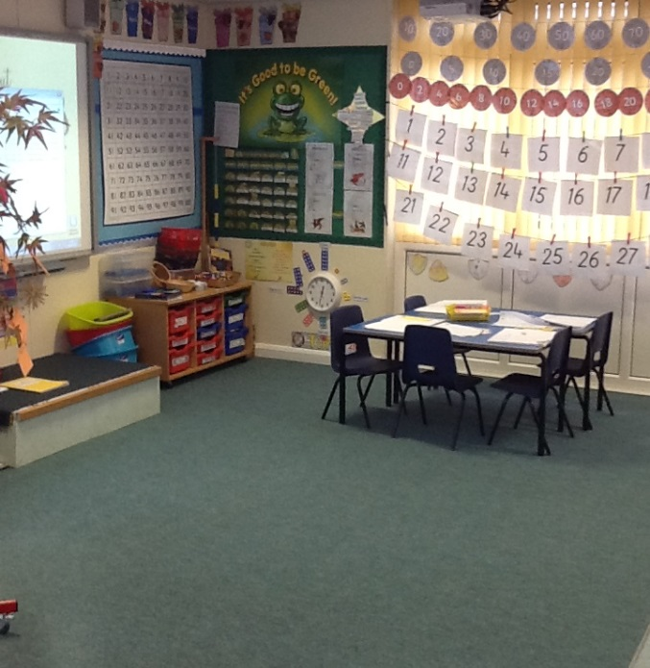

Y1 classrooms
This is Miss Pavier’s classroom.
This is Miss Hall’s classroom.
When your child comes into school in the morning, there will be activities or a morning task for them to complete, as this helps them to settle quickly and get ready for the school day.

Slide 8
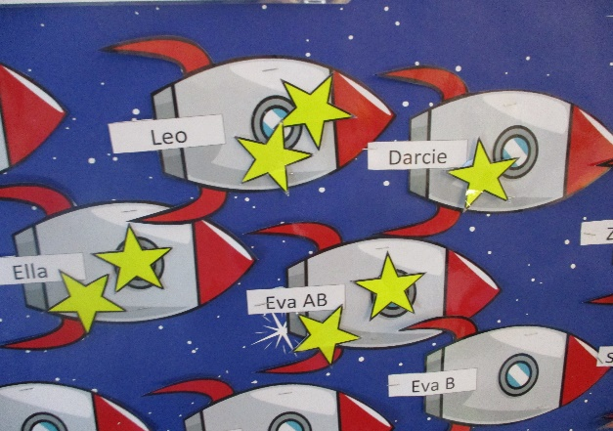
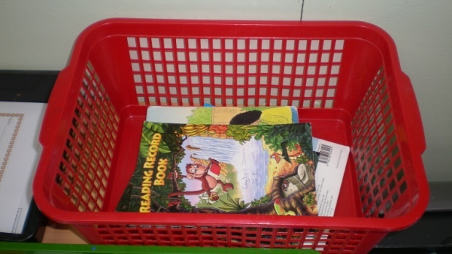

Reading
We love to read in Year 1 and have charts to reward regular readers.
We will change reading books on a Monday and a Thursday.
Please read regularly with your child. It is one of the most important things you can do with your child and it makes a huge difference. It is not necessary to read an entire book every night and it is recommended that your child keeps the same book to re-read several times to build up their fluency. This is why we will change books only twice a week. When a book does need to be changed, please remind your child to put it in the basket on the designated days so that staff can change them.

Slide 9
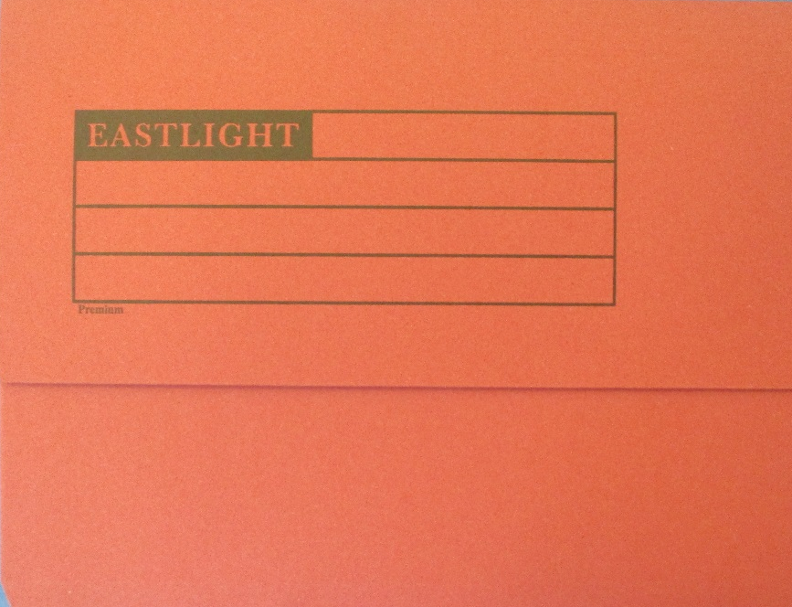


Homework
Each week you will get set maths, reading and spelling or phonics homework. Homework will be set on TEAMS. If homework consists of resources that need sending home, these will be added to your child's homework folder. Please make sure these folders stay in your child’s bag just in case they are needed.
Homework is set on a Friday and needs to be completed and handed in on TEAMS by the following Wednesday.

Slide 10
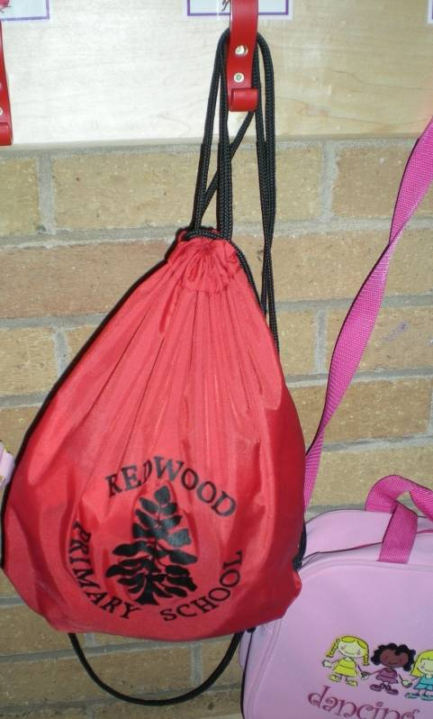

P.E.
Bring your PE kit into school on a Monday and leave it here all week. We only have a limited amount of spare kit that we can loan.
Indoor PE kit should consist of: a pair of shorts, a t-shirt, plimsolls or trainers.
You will also need an outdoor PE kit for a Tuesday afternoon. It might be a good idea to have this in a separate bag if you have one!
Outdoor PE kit should consist of: jogging bottoms, a t-shirt, a warm top such as a hoody or jumper and trainers.
You will need to tie long hair back ready and earrings should be removed at home on PE days.

Slide 11
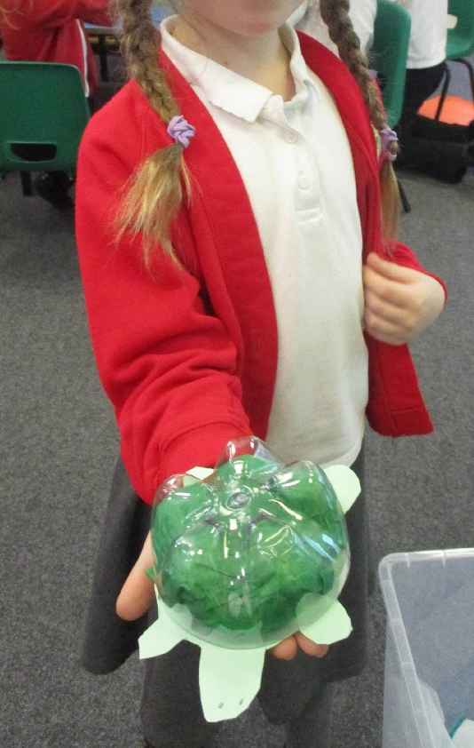

Show and Tell
As much as we love to see your child’s favourite toys, we would like you to keep these items at home. They can become lost, damaged and can be a distraction in the school day. Your child will have an opportunity to share things with the class during ‘Show and Tell’ sessions. We love to see things they have made and photographs, rather than soft toys and games. Each class will have a set day for ‘Show and Tell’, so please do not send your child in with items on any other day, as they won’t get the chance to share them.

Slide 12

Finally here are some ways that you can help us:
Keep toys at home.
Encourage your child to bring in something that they have made or share photographs during ‘show and tell’ sessions.
Write in your child's reading record when they have read.
Gently remind your child to change their reading book on the designated days.
Support your child with their homework routine. Complete, upload and hand in homework on TEAMS.
Encourage your child to bring in their PE kits on a Monday.
Take out earrings and tie hair back on PE days.
Encourage your child to come into school independently.
Label all of your child’s clothes and belongings.

Slide 13

Answering your questions:
How is it decided which children will be in each class?
Classes are firstly organised according to your child’s date of birth. Children in the Y1 class will usually be the youngest children in the year group. Older children will usually be in the mixed Year 1/2 class. However, we also have to look at the number of boys and girls within each class to make sure it is roughly equal.

Slide 14
Answering your questions:
Will my child be taught the same things in Year 1 whichever class they are in?
We plan together in Year One and children within each year group will be taught the same learning objectives and be assessed in the same ways. Teachers may choose to deliver an objective in a different way but the same content will be covered regardless of which class your child is in. We follow the same Maths, Phonics and English planning and we use the same plans and resources for other subjects within the curriculum.

Slide 15
Answering your questions:
Can we do anything to help at home, over the summer holidays?
You have already got lots of experience of home schooling your child over the last year and probably know where you can find resources and extra activities that you can do with your child. Reading with your child is one of the most important ways that you can support your child. Regularly playing phonics games and recapping the phase 3 sounds will also be a great help. Helping your child to become more independent, such as getting dressed for PE will also build their confidence ready for returning to school in September.

Slide 16

We look forward to seeing you in September!

